Slide 1
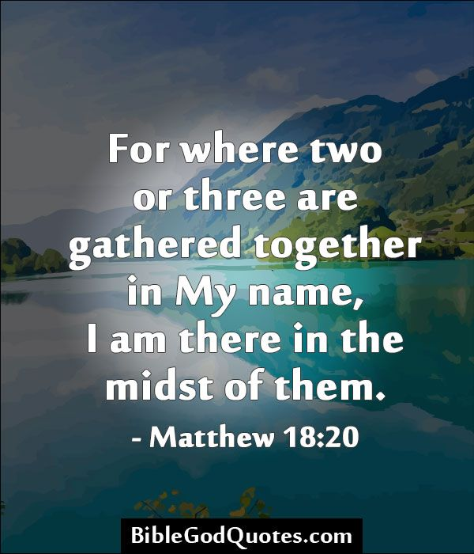

A Prayer Service on Return to School
Notes:
Bible; Candle; Music;
Welcome staff
Explain theme of prayer service

Slide 2
Opening Prayer …
As we gather here today on our return to school,
we thank you, Lord, for your friendship and protection.
We ask that You will strengthen us, restore us and inspire us
to know what is right and to do what is just.
Come fill our lives with your love.
Fill our conversations with your grace and truth,
fill this meeting today with your presence.
We ask this through Christ Our Lord.
Amen
A Prayer Service on Return to School
Notes:
Light the candle
Pray the Opening Prayer together

Slide 3
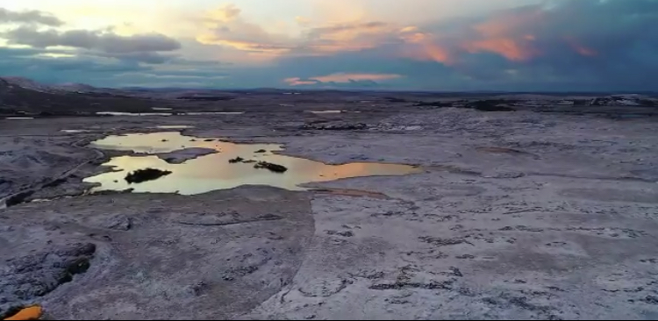
Be still and know …
A Prayer Service on Return to School
Notes:
A few moments of quietness, stillness, taking time to be in God’s presence, to set aside the cares and worries – to be still

Slide 4
Take a few moments to bring to mind these people and events of the past year: your family your work colleagues those with whom you have had difficulties and challenges everyone who has held significance for you anyone or anything else that comes to mind
A Prayer Service on Return to School
Notes:
Allow time for quiet personal reflection

Slide 5
Now think of the following: your happiness your successes the difficult things that helped you to grow your insights and awareness whatever else seems like a gift to you
Offer a prayer of gratitude for the school year/term just completed with all its blessings and opportunities for growth.
A Prayer Service on Return to School

Slide 6
Take a few moments to think about the following: your concerns your cares your hopes your dreams your joys
Offer a prayer of hope as you begin the school year/term
A Prayer Service on Return to School

Slide 7

Listen … 1 Timothy 6: 11-16
A Prayer Service on Return to School
Notes:
This may be read by one member of staff

Slide 8
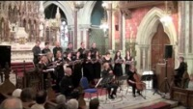
A Prayer Service on Return to School
Notes:
You may choose to play this piece of music and listen to the words
Eirim suas le Dia, Ronan McDonagh
Here in Christ We Gather, Ephrem Feeley
Or choose something else or conclude with a prayer/school prayer

