Slide 1
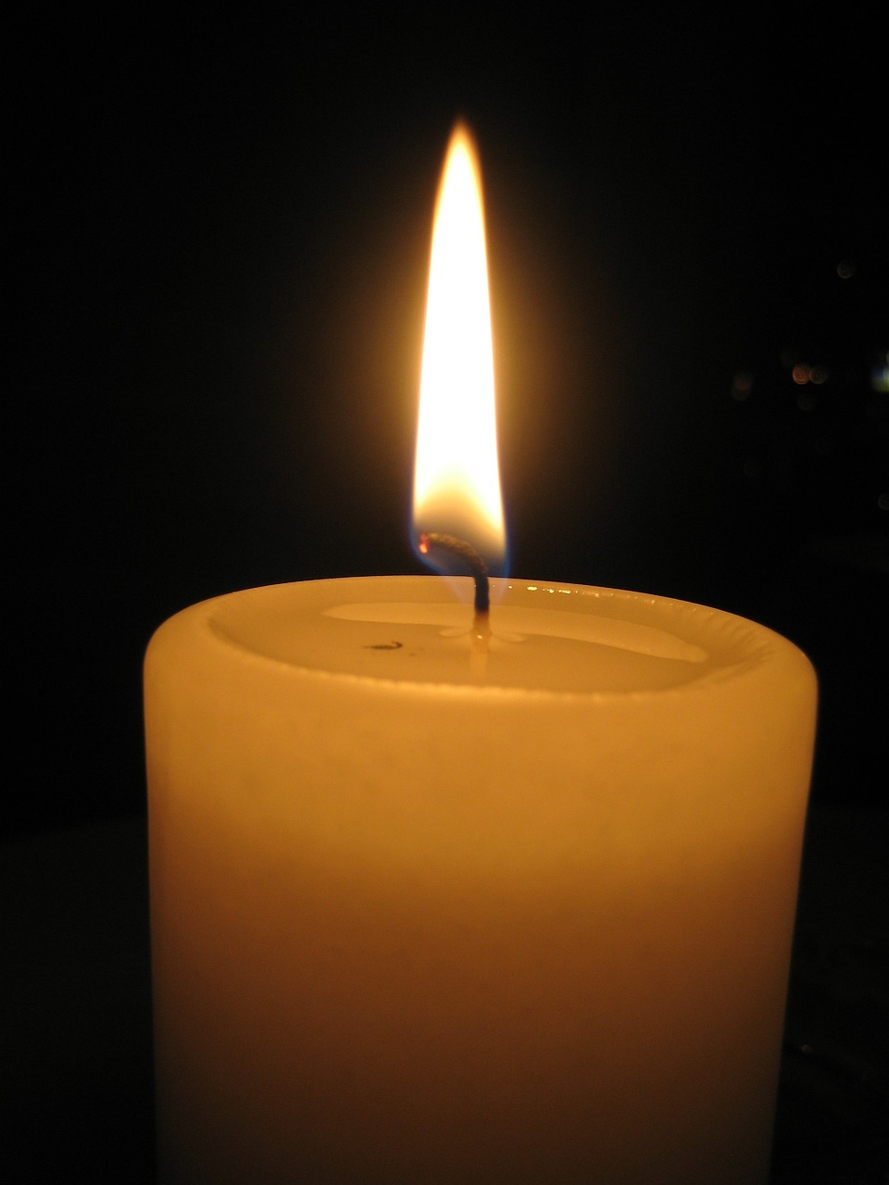

A time to be still …
A Quiet Time
Notes:
Prepare the space to be used – chairs, candle, bible, music, PowerPoint if using this
light the candle
Bible; Candle; Music;
Welcome staff
Explain theme of prayer service

Slide 2
Opening Prayer …
Come Holy Spirit, guide and enlighten us
That we may impart God’s wisdom and understanding
To the young people in our care.
May we help them in their quest for knowledge
And in living just and upright lives.
Spirit of wisdom and understanding
Fill our hearts as we begin our meeting today.
Amen
Quiet Time
Notes:
Invite staff to sit comfortably
Put any items on the floor
Pray Opening prayer together

Slide 3
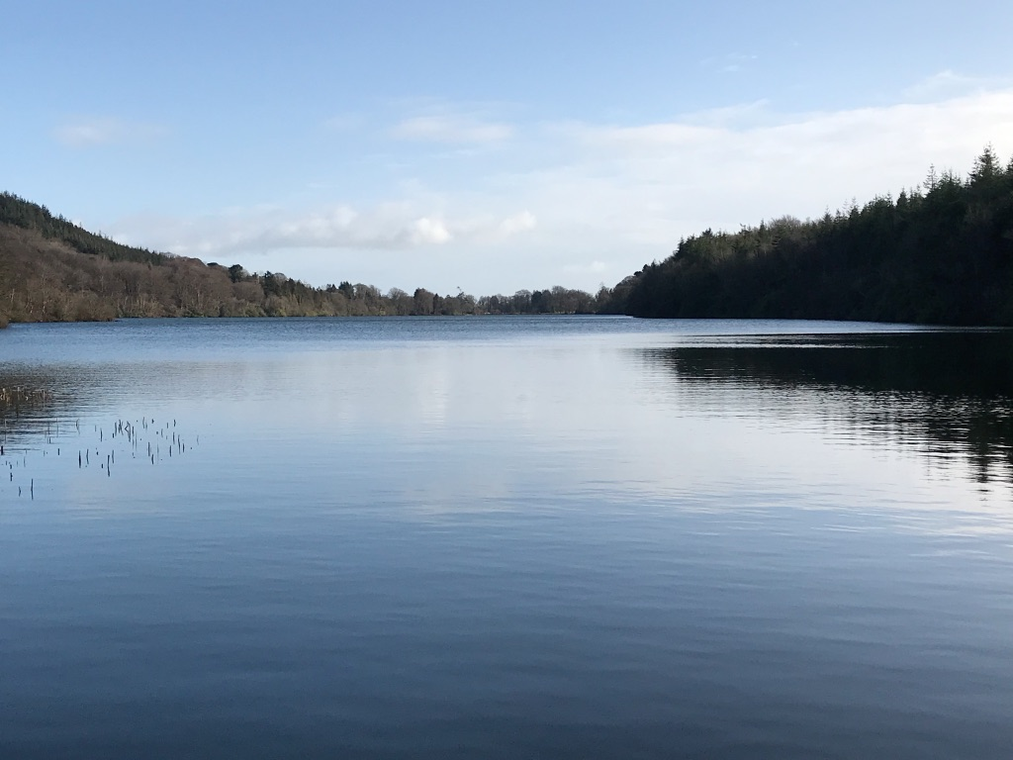
Be still and know …
Quiet Time
Notes:
A few moments of quietness, stillness, taking time to be in God’s presence, to set aside the cares and worries – to be still

Slide 4
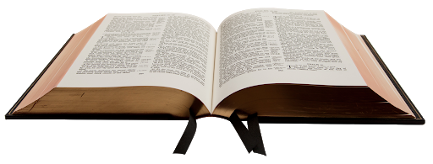
“Even the wind and the sea obey him”
Mk 4:35–41; Mt 8:23-27; Lk 8:22-25
Quiet Time
Notes:
This may be read by one member of staff or shared between a few members – plan in advance
The Gospel should be read slowly, meditatively, with pauses between sentences
After a few moments you may read the passage again

Slide 5
Meeting Jesus in the Gospel …
God has called me here today, now, for a reason.
Now is the time to reflect and
find that reason and hear what God has chosen to tell me.
What does this Gospel passage say to me?
What has drawn my attention or struck me in some way?
Why? Was it a person? A word? A situation? A gesture?
What is God saying to me through these words today?
Quiet Time
Notes:
Decide on a time limit for this reflection period
There is no pressure
It is entirely personal
Let the Gospel passage speak to you
Jesus rebukes the storm with authority. What does this tell me about Jesus’ relationship with his disciples?
Hold the word/phrase/gesture as the passage is re-read to memorise and contemplate

Slide 6
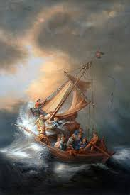
God has spoken to me
What is my reply?
Quiet Time
Notes:
Allow time for quiet prayer
Decide on length of time before you begin

Slide 7

Final Prayer …
Quiet Time
Notes:
You may choose a prayer to pray together e.g. school prayer
Choose another piece of music or hymn or have someone play or sing a hymn
Do Not Be Afraid, Bernard Sexton
Our Eyes are Fixed on the Lord, Ephrem Feeley

